Slide 1
listen …

Slide 2
GES1011/GESS1009
The Evolution of a
Global City-State

Slide 3
an island …

Slide 4
“Both countries need to be open with each other...keep in mind Singapore will always be there and we (Malaysia) will always be here…we have to find ways … of living together because geography doesn’t change”.
Chandra Muzaffar, 26 December 2018

Slide 5
task for today ...
we want to make some guesses about the geological story of this island ...
has it always been around ?
has any commentator ...
pondered this matter, or raised this question?*

Slide 6
in lieu of an introduction …
since we (human beings) acquired the ability to communicate (even before language) …

Slide 7
in lieu of an introduction …
we have been having conversations …

Slide 8
in lieu of an introduction …
conversations about
the cosmos,
the planet,
the weather,
our observations,
our feelings,
our actions,
our similarities,
our differences
etc. …

Slide 9
this module …
welcome to
human conversations …

Slide 10
this module …
welcome to the humanities …

Slide 11
this module…
more specifically, we are going to have human conversations
pertaining to ‘Singapore’ …

Slide 12
this module…
conversations mainly about Singapore’s pasts,
specific bits of its present,
alongside some considerations about its future …

Slide 13
this module…
regardless of your
faculty,
departmental,
or disciplinary
affiliation …

Slide 14
this module…
it is not difficult
to take part in these conversations …

Slide 15
this module*…
just embrace your humanity,
be willing to make observations,
talk about them,
ask questions,
listen,
read a little,
rekindle your sense of wonder,
and exercise your imagination …

Slide 16
this module…
and you will learn …

Slide 17
Question and Answer
RESPONSE
______

Slide 18
Question and Response

Slide 19
this module …
with reference to Singapore, you are taking part in a conversation that has been going on for a long time …
we are unsure exactly how long but will document it in the course of this module …

Slide 20
this module …
how old is Singapore?*
57 years, 7 days, eight + hours …
203 years (LHL speech, 1997) …
700 + years …
1000 years …
8500 years …

Slide 21
this module …
how old is Singapore?
it depends …
in what sense are you using ‘Singapore’?
physical space ?
outpost of British empire ??
politically independent entity ???
trading point ????
?????

Slide 22
this module …
in the next few minutes, we will take a brief look at someone who has artistically engaged in conversations about Singapore …

Slide 23
this module …
considering and imagining Singapore’s past …

Slide 24
interpreting Singapore’s past …
Hossan Leong offers an interpretation of Singapore, its deeper and relatively recent past …
in doing so, Leong has made a series of choices (consciously and otherwise) …

Slide 25
interpreting Singapore’s pasts …
who and what to include …
how to string it together and present it …
calling it ‘Singapura’ not ‘Singapore’ …

Slide 26
interpreting Singapore’s pasts …
are these choices with or without significance?*
if yes, what is it’s significance?
importantly, Leong’s emphasises people, events and icons in the more recent past …
Leong’s take reflects scholarly efforts at narrating Singapore’s history …
and like Leong, you need to muster the courage to make your own choices and offer your interpretations …

Slide 27
scholarship on Singapore’s pasts …
while Leong is being playful (and a bit snarky)...
scholarship on Singapore (more seriously) tells a somewhat similar story ...
scholars have long emphasised Singapore’s story begins with Raffles arrival in 1819 (Turnbull)…

Slide 28
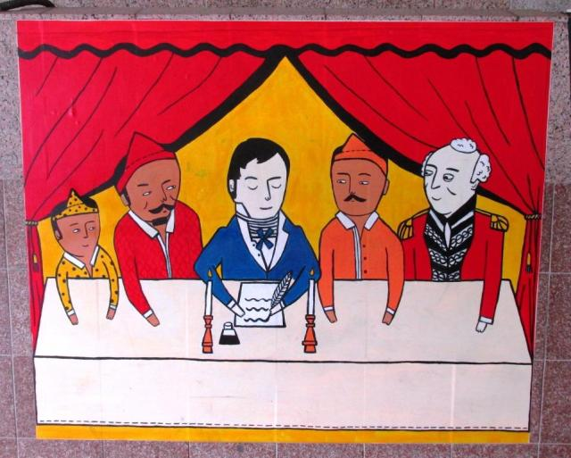
scholarship on Singapore’s pasts …

Slide 29
scholarship on Singapore’s pasts …
a group of scholars: Kwa Chong Guan, Derek Heng and Tan Tai Yong offered a new/different/re-interpretation of Singapore’s past in the mid-2000s ...
with the addition of Peter Borschberg, a second edition was launched in 2019 (bicentennial) …
the difference between Kwa and co. and those who came before them …
an effort to extend Singapore’s narrative from the last 200 to 700 years …

Slide 30
scholarship on Singapore’s pasts …
impetus for Kwa and co. ...
mainly archaeological sources discovered since the 1980s (John Miksic) Lecture 3 …
however, besides using a different type of source, Kwa and co.’s interpretation also tell Singapore’s story through an emphasis on people and events …
but with a wider regional focus Lectures 2 and 3 ...

Slide 31
Question and Response

Slide 32
this module …
imagining Singapore’s past/s …

Slide 33
this module …
imagining Singapore’s past (playfully, seriously, comedically, politically etc.) …
historically imagining Singapore’s past (Tutorial 1) …

Slide 34
this module (present manifestation) …
historically imagining Singapore’s past …
as part of a larger global unfolding (cosmological, geological and human) ...

Slide 35
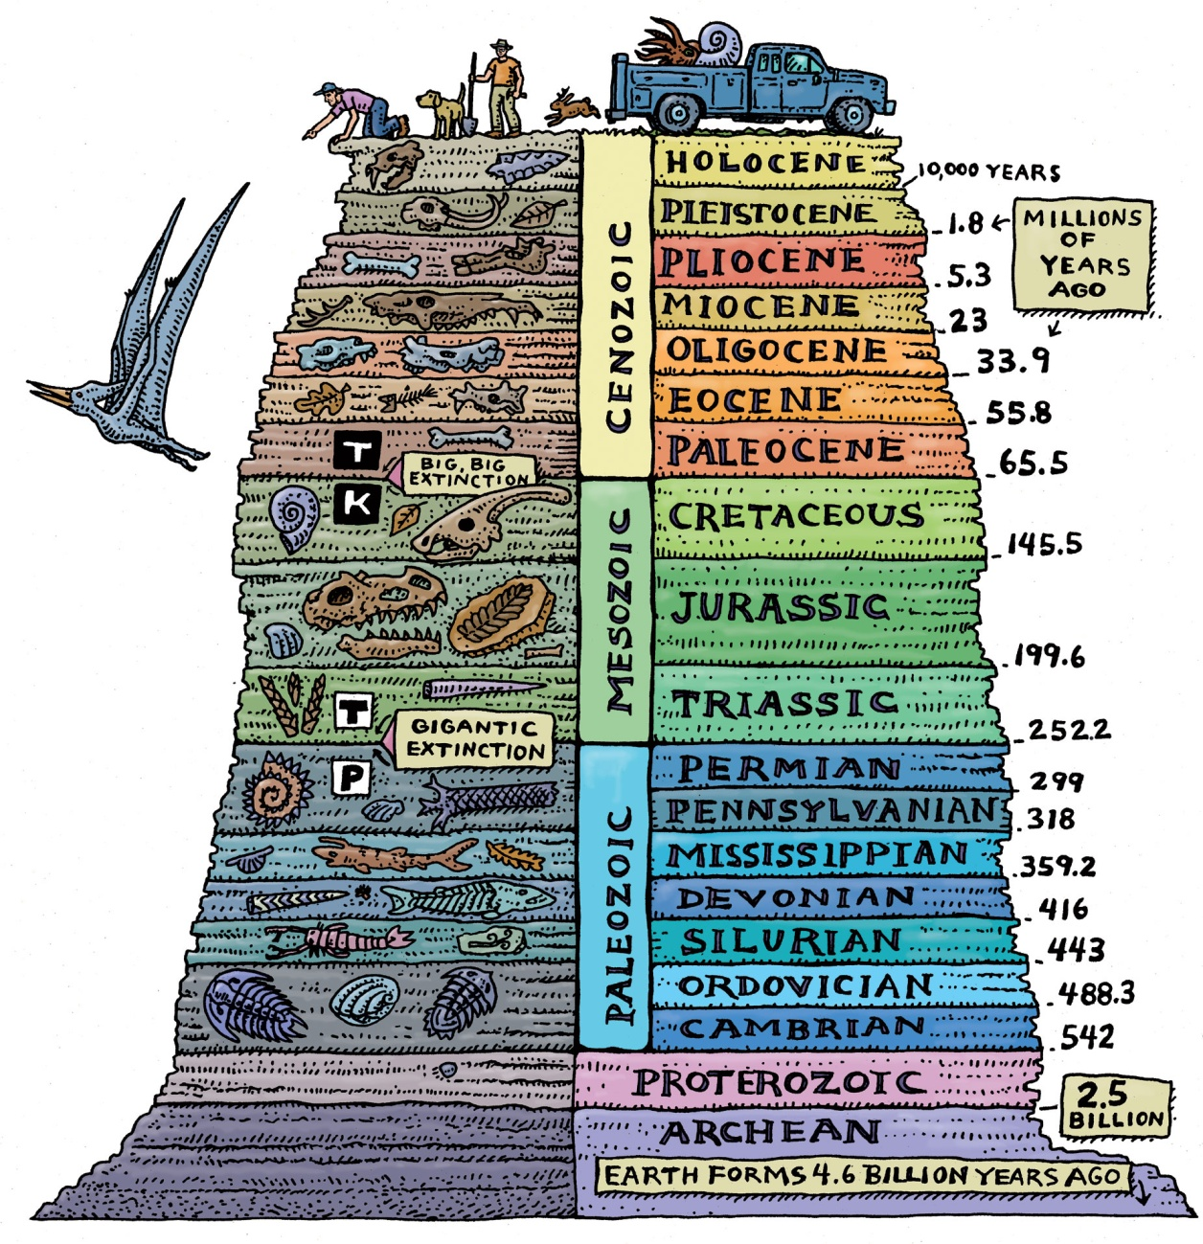
this module (present manifestation) …

Slide 36
this module (present manifestation) …
briefly go beyond the region …
beyond human linked efforts and effects (like trade and religion) …
and bring in wider forces …

Slide 37
an island ...
we want to make some guesses about the geological story of this island ...
has it always been around ?
has any commentator (Leong and Lee) you encountered today ...
pondered this matter, or raised this question?*

Slide 38
an island ...
why do we not question our geological context?
islands in the region have disappeared in the last 150 -200 years ...
April 1815 … Tambora quake …
August 1883 … Krakatoa quake …

Slide 39
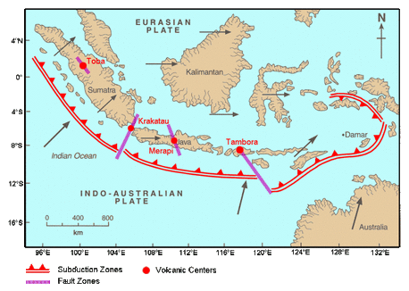
an island ...

Slide 40
an island ...
and just as geological formations come into being ...
they can also fade away/disappear/morph/ etc ...
‘Singapore’ is clearly not immune to such forces …

Slide 41
an island ...
the earth/environment/cosmos is far from static ...
maybe not quite “alive” in a literal or immediately observable sense ...
it surely continues to be in a state of flux ...
and needs to be thought about as anything but unchanging ...

Slide 42
an island ...
cycles of warming and cooling ...
tectonic movement ...
cosmological events ...
have, among other things, shaped the geological story of this planet (and with it, ‘Singapore’) ...

Slide 43
a geological unfolding …
so let’s roll back the years ...

Slide 44
a geological unfolding …
watch …

Slide 45
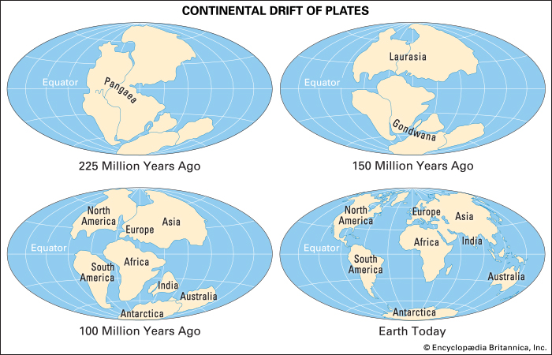
a geological unfolding …

Slide 46
a geological unfolding …
watch …

Slide 47
a geological unfolding …
watch …

Slide 48
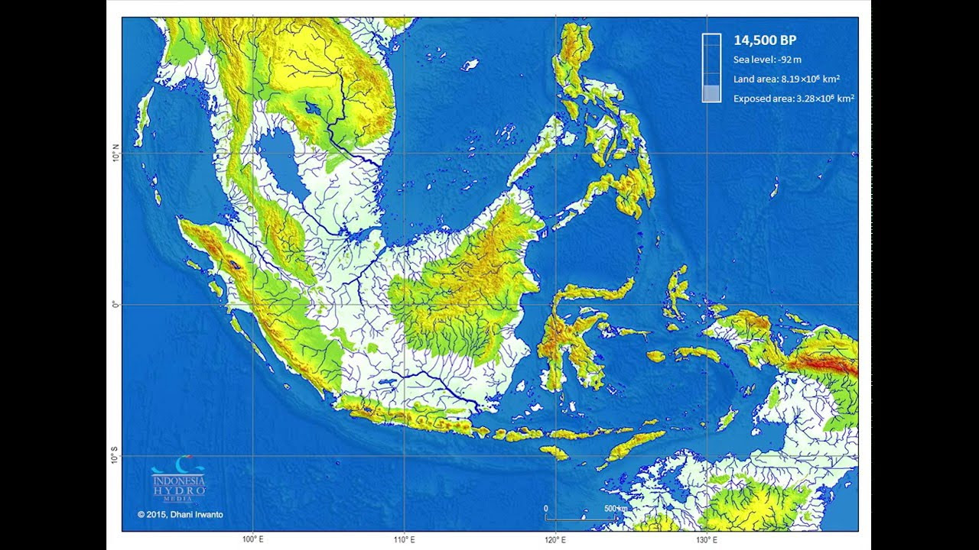
a geological unfolding …

Slide 49
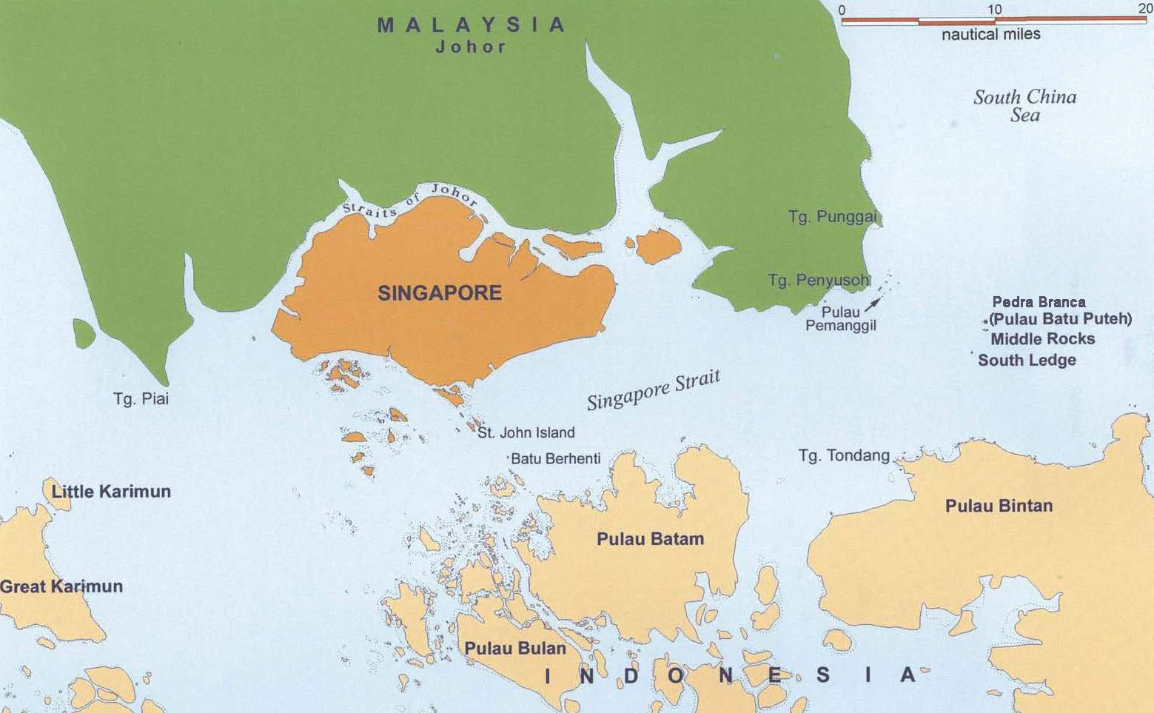
a geological unfolding …

Slide 50
a geological unfolding …
long-term sea level change, as opposed to tidal or seasonal changes, may be attributed to at least three groups of observable causes, that is:
change of the water volume in the oceans
change in the volume of the ocean basins
human activities*

Slide 51
a geological unfolding …
glacial factor: during glacial periods water was extracted from the sea to develop glaciers …
meltwater from the glaciers returned to the sea during warm interglacial periods …

Slide 52
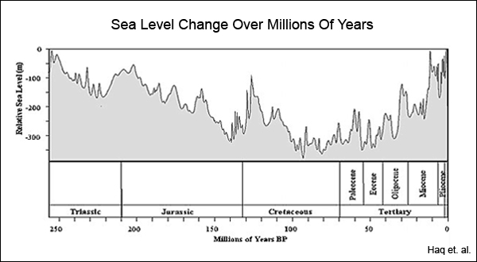
a geological unfolding …

Slide 53
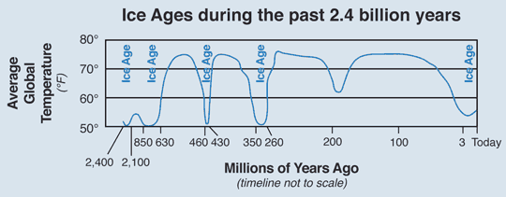
a geological unfolding …

Slide 54
a geological unfolding …
during the Quaternary Era (last 1.8 million
years of Earth's history) …
many glacial and interglacial intervals had alternated
resulting in lowering and raising sea levels …
perhaps as low as 130 m below and …
as high as 30 m above present sea level …

Slide 55
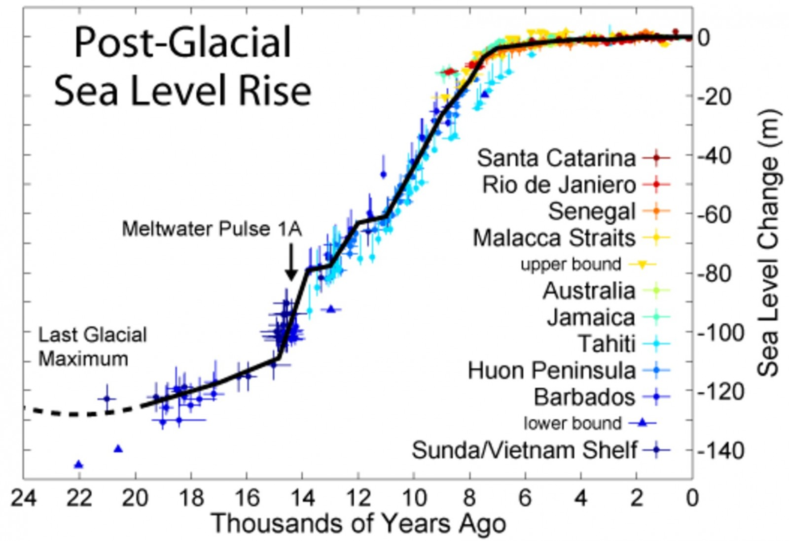
a geological unfolding …

Slide 56
a geological unfolding …

Slide 57
in lieu of a conclusion …
geological past of 1°09’N and 1°29’N, and, 103° 38’E and 104° 06’E …
is very much connected to a much larger unfolding …
but it remains part of 1°09’N and 1°29’N, and, 103° 38’E and 104° 06’E ‘s story …

Slide 58
in lieu of a conclusion …
it is a story that needs to be integrated into histories of ‘Singapore’ …
as there is more to these histories than human activity …

Slide 59
this module …
how old is ‘Singapore’?*
57 + years …
203 years (LHL speech) …
700 + years …
1000 years …
8500 years …
it depends …

Slide 60
“Both countries need to be open with each other...keep in mind Singapore will always be there and we will always be here…we have to find ways … of living together because geography doesn’t change”.
Chandra Muzaffar, 26 December 2018

Slide 61
in lieu of a conclusion …
next week …
we commence a history of human activity in the areas surrounding 1°09’N and 1°29’N, and, 103° 38’E and 104° 06’E …

Slide 62
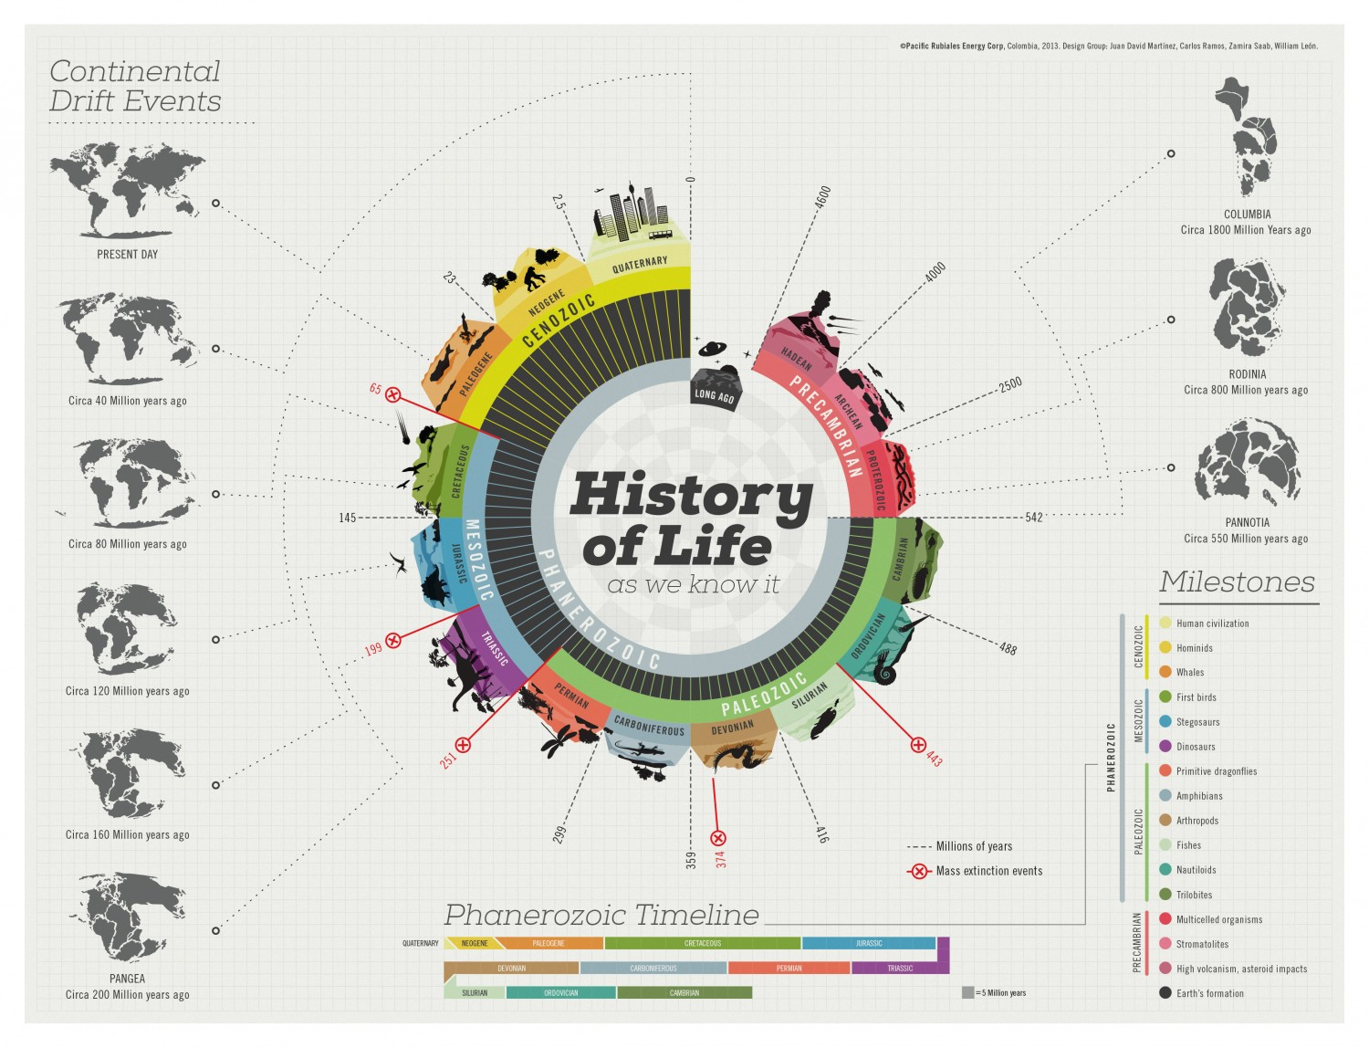
a geological, biological and cultural unfolding …

Slide 63
Question and Response

